Slide 1
How can you help? Does your child want you to…
Leave them to it, warning them about living in a cardboard box if they don’t revise?
Confiscate their phone to stop them contacting their friends on Instagram?
Be around– not in the room, but pottering about nearby to provide a kind of non-intrusive monitoring?
Show an interest when you return from work and offer to test you or simply make them cups of tea?
Empathise rather than go on the attack? Even small remarks can aggravate fear, such as saying, “Have you looked at your timetable?” or, “Do you know what you need to revise?”
Offer to help drafting a revision timetable?
Take charge of ‘back room operations’, making sure they have a well-ordered, quiet workspace with all the Post-it notes and fluorescent pens they need?
Discuss removing their games console from their bedroom until exams are over?
Ask them what they want from you?
Ask “If I think you are not doing enough work, am I allowed to say anything and what’s a good time to say it?”
Check they know how to revise?

Slide 2

WELCOME to
The 2026 Parents’ Revision Evening
Notes:
Reasons for changing: The format – revision and learning are complex processes and we didn’t feel we could do them justice in an hour’s lecture. The next 5 months will affect the whole family (not just the students) so crucial that you are together hearing the same message sand so can work together. Previously before mocks – too far from the real thing; previously last minute – will contradict much of what we’ll tell you. Today. This gives enough lead in and should also complement responses to the mocks…

Slide 3
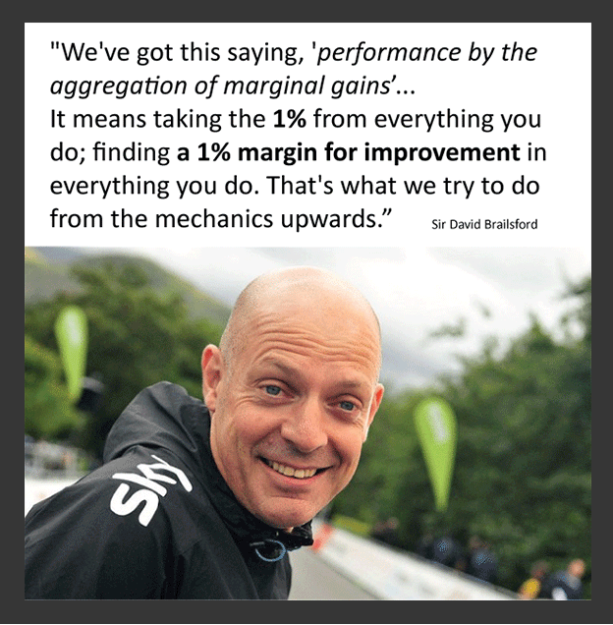

Slide 4
Day | Date | Subject
M | 19/2 | History: The Norman Conquest
T | 20/2 | Maths
W | 21/2 | GCSE PE
M | 26/2 | English Literature Paper 1 (A Christmas Carol and Macbeth)
T | 27/2 | Food, Textiles, RM
W | 28/2 | Science: Session 1 – Triple Biology, Trilogy Higher Chemistry, Trilogy Foundation Physics
M | 4/3 | OCR Sport | Geography: Deconstructing 9 mark questions (targeting grade 5)
T | 5/3 | Maths
W | 6/3 | GCSE PE
M | 11/3 | English Language Paper 1 (fiction)
T | 12/3 | Food, Textiles, RM
W | 13/3 | Science: Session 2 – Triple Chemistry, Trilogy Higher Physics, Trilogy Foundation Biology
M | 18/3 | OCR Sport | History: The People’s Health
T | 19/3 | Maths
W | 20/3 | GCSE PE
M | 8/4 | OCR Sport | History: Goodrich
T | 9/4 | Maths
W | 10/4 | GCSE PE
F | 12/4 | Geography: Deconstructing 9 mark questions (targeting grade 7+)
M | 15/4 | English Literature Paper 2 (An Inspector Calls and Poetry)
T | 16/4 | Food, Textiles, RM
W | 17/4 | Science: Session 3 –Triple Physics, Trilogy Higher Biology, Trilogy Foundation Chemistry
M | 22/4 | English Language Paper 2 (non-fiction)
T | 23/4 | Maths
W | 24/4 | Geography: Data manipulation, graphs and statistics
M | 29/4 | History: The Making of America
T | 30/4 | Food, Textiles, RM
W | 1/5 | Maths

Slide 5
A starting point for revision:
Each subject has produced a revision overview which is on the school website:
Curriculum – Academic - KS4 subjects – Year 11 Revision Information
Exam board
Assessment summary
Past Papers and Mark Schemes
Useful Revision Websites
Revision apps
Recommended revision guides
Other useful information

Slide 6
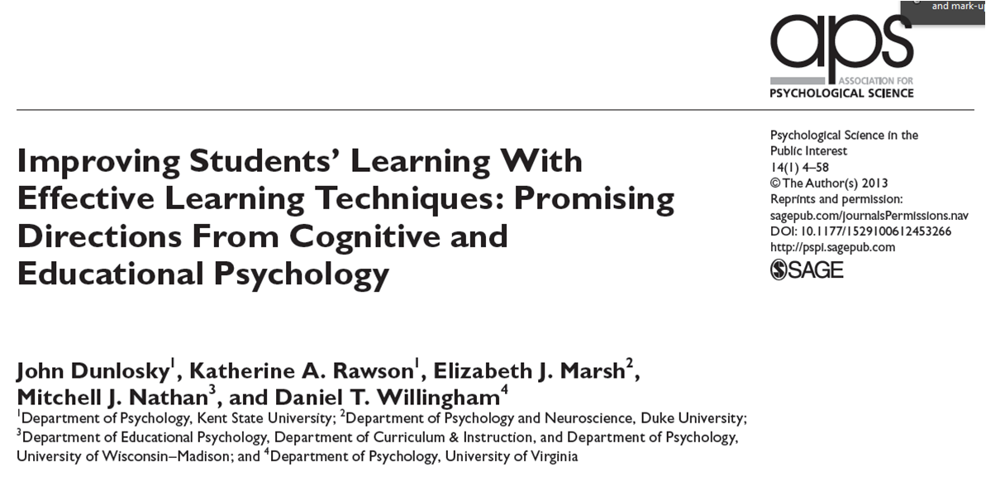
The Revision Process
Notes:
Last 5/6 years has seen an enormous growth of interest and activity in the science of learning – seems bizarre that there wasn’t more before. People have tended to revise and prepare for exams in the same ways for years. Still a lot of good sense in some of those methods but there are others that research has proved to be ineffective and others that may initially seem counter-intuitive but improve knowledge retention….

Slide 7
Not very effective

Slide 8

Re-reading

Slide 9
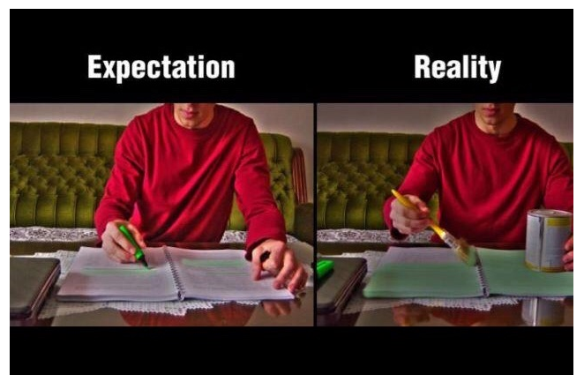
Highlighting

Slide 10

Why?
Low challenge.
Little thinking required.
No quality assurance i.e. how do you know it’s working?
Makes the student think that they are ‘doing something’

Slide 11
And yet...
  59% of Year 11 students thought re-reading notes and text-books was effective;
  31% of Year 11 students thought highlighting notes was effective.

Slide 12
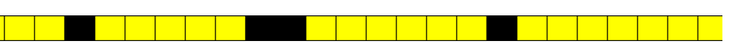
What did schools do in 2025?
Citizenship
94%
Contingency
94% of Year 11 attended full-time up to the May half term.

Slide 13

Context
Study leave from some time in May was ‘normal practice’.
The legal school‑age requirement is attendance until the last Friday in June.
Citizenship
Legal end of Year 11

Slide 14
DfE updated expectations:
Reminder: compulsory attendance until the last Friday in June.
Reminder: study leave is not a legal entitlement.
Any study leave should be used sparingly.

Slide 15
Benefits
“Year 11 staying in school longer shows improved outcomes, reduced anxiety, and offers greater support for revision activities. Students are more focused, better supported, and more likely to achieve their potential when they remain in structured learning right up to their final exams.”
DfE, April 2025

Slide 16
Schools that reduce study leave report improved exam results
Students revise more effectively with structure.
Teachers can target final gaps and misconceptions.
Timely intervention stops avoidable errors just before exams.
Structure and support to sustain revision over long unsupervised periods
Spot early warning signs (lateness, avoidance or anxiety)
Allows friends to support one another

Slide 17
What will Gloucestershire schools do in 2026?
Citizenship
Contingency
February
March
April
May
June
July
J
K
A
F
H
M
C
E
G
I
N
O
B
D
H
L
P

Slide 18
What will we do?
Citizenship
Contingency
February
March
April
May
June
July
J
K
A
F
H
M
C
E
G
I
N
O
TK
B
D
H
L
P

Slide 19
Citizenship
Contingency
February
March
April
May
June
July
Supported Study
All attend
To 22/05
Supported Study
Attendance Optional
From 01/06
Subject Revision/Teaching
All attend
Looking
Ahead Day
01/05
At TK, in common with 94% of schools in 2025, students remain in school up to the May half-term.
After this point, continue with supported study in school or opt to study at home from Monday 1st June.
Parental application for dispensation to study at home from 7th May,

Slide 20

Timescales
First exam is on 7th May
Last exam is on 16th June (24th for contingency)
21 out of 53 exams before May half term – implications for revision?

Slide 21
Term time revision
Day | Date | Subjects
Monday | 17 March | Maths | Science | Option A
Tuesday | 18 March | English | Option B | Option C
Weds | 19 March | Maths | Option D | Option A
Thursday | 20 March | Science | Option B | Option C
Friday | 21 March | English | Maths | Option D
Saturday | 22 March | Science | Option A | Option B
Sunday | 23 March | English | Option C | Option D
Monday | 24 March | Maths | Science | Option A
Tuesday | 25 March | English | Option B | Option C
Weds | 26 March | Maths | Option D | Option A
Thursday | 27 March | Science | Option B | Option C
Friday | 28 March | Maths | English | Option D

Slide 22
152 hours
20 hours Feb half term (20)
1 hour each night Monday-Thursday (44)
2 hours each weekend (18)
50 hours Easter holiday (50)
20 hours May half term (20)

Slide 23
152 hours
20 hours Feb half term (20)
1 hour each night Monday-Thursday (32)
2 hours each weekend (16)
50 hours Easter holiday (50)
20 hours May half term (20)
152 hours divided by 9 subjects
= 17 hours per subject
to revise 2 years’ work!

Slide 24
So...
How do you make the most of that time?

Slide 25
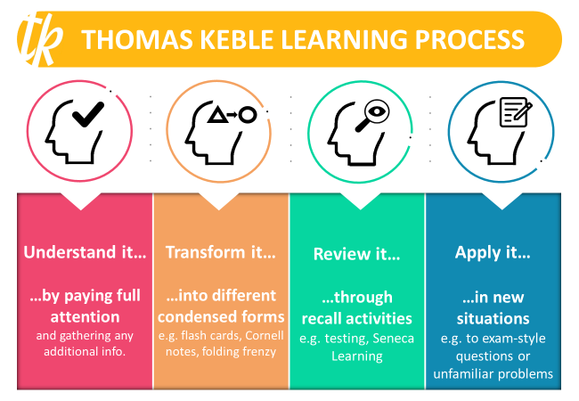

Slide 26


What is our biggest
FEAR about 'being assessed'?

Slide 27
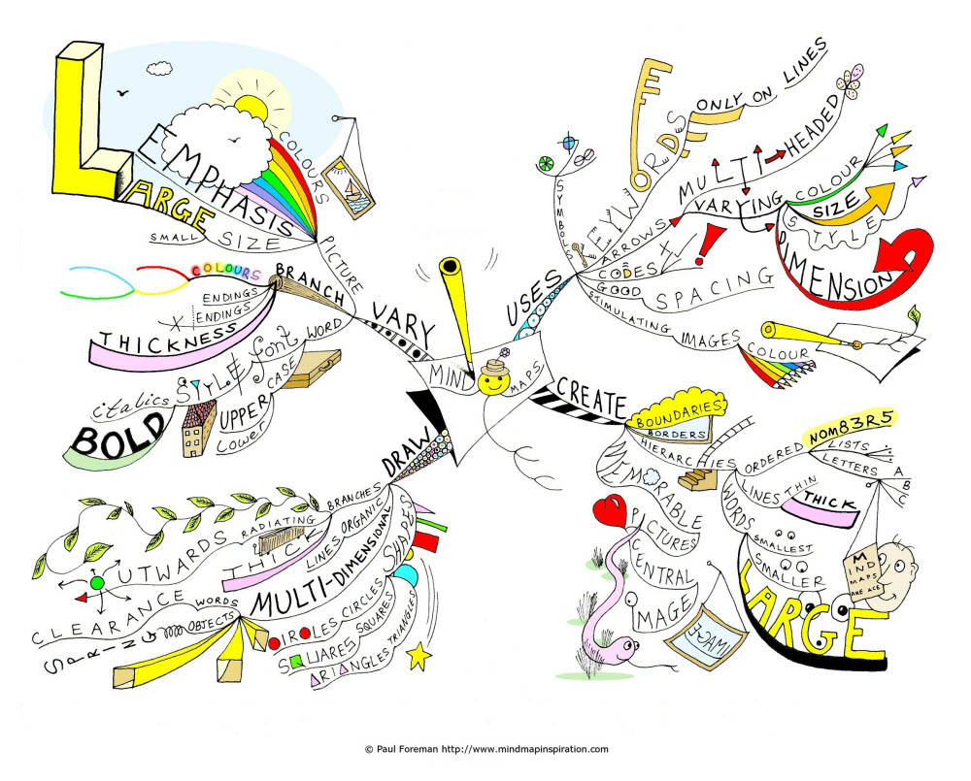
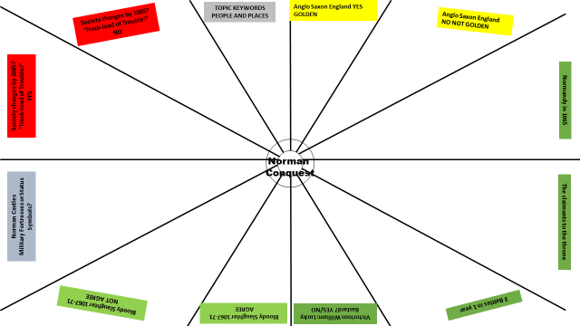
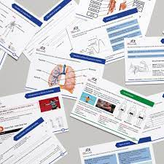
How do we know if we ‘know it’ if we don’t ‘test it’?
SIMPLE ANSWER……..WE CAN’T
The degree of success in TRANSFORMING learning can only be gauged if we TEST to see HOW MUCH WE REALLY KNOW

Slide 28

Students forget 90% of what they learn in class within 30 days
(however much they enjoyed the lesson
/the subject matter was taught well)

Slide 29
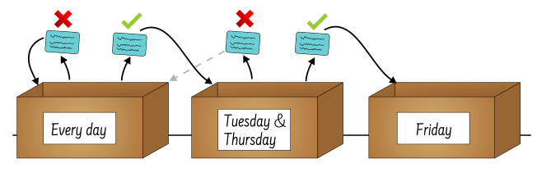
The Leitner Method
Self-testing + active recall
=
Improving memorisation through spaced repetition

Slide 30
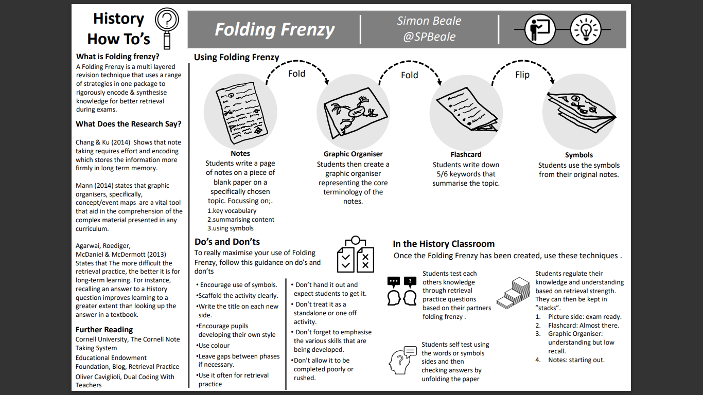


Slide 31
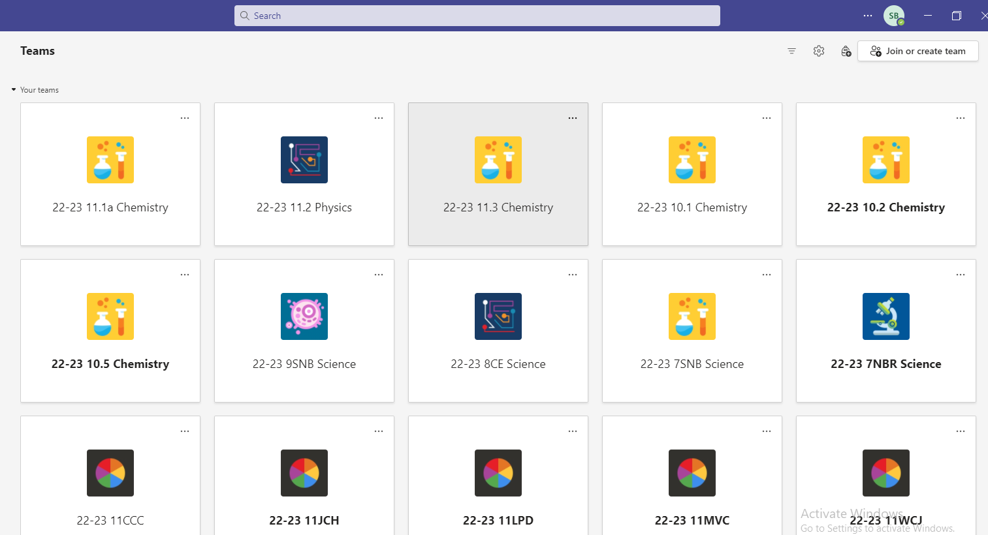
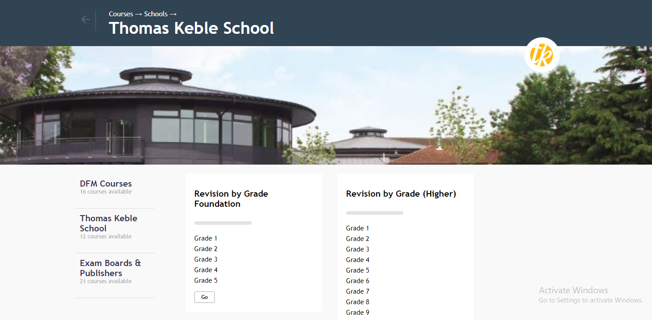


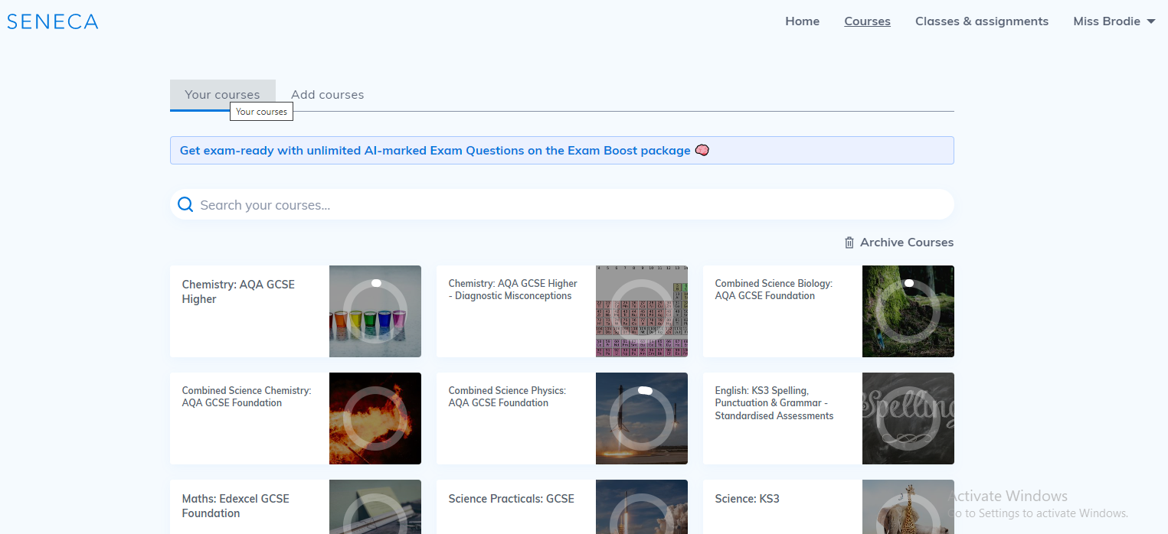




Dr Frost Maths
TEAMs
Seneca

Slide 33
Self-testing and diagnosis of errors
Understanding of the subject
Exam technique
Did you get it wrong because you didn’t know that part of the subject?
Solution: focused revision
Use Folding Frenzy/flashcard envelopes
/Seneca/Quizlet
Did you get it wrong because you didn’t read the question properly or lack of experience with the EXAM PAPER?
Or because you didn’t do exactly what the MARKSCHEME wanted?
Or you haven't seen enough MODEL ANSWERS?
Solution: repeated deliberate practice using the 3 aids above

Slide 34
What is your biggest
FEAR about
THE EXAM PAPER…….?

Slide 35
Anticipation of starting – have the topics that I want to come up, come up?
Getting going … turning the page, the first question.....
Being aware of other people in the hall – how fast they are writing, their body language..
Time Management
Stronger/weaker question types
Understanding the COMMAND word in the question
Thinking about what happened LAST TIME I did this paper

Slide 36

Knowing your stronger/weaker question types and confronting them by practising where you are weaker.......
Doing back-to-back questions, different combinations
Working out the timing for each section/question and practising TO THAT TIME

Slide 37
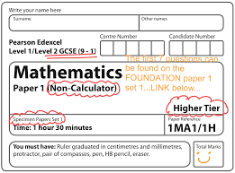
KNOWING and USING the markscheme

Slide 38


Using Model Answers to help
Question 6a
In Interpretation A
the historian Robert
Bartlett argues that
the ‘Harrying of the
North’ had a powerful
impact on northern
England. Identify and
explain one way in
which he does this.
[3]
Let’s look at an example.
Remember: You will be awarded 1 mark for the identification of a relevant and appropriate way in which the historian argues that the ‘Harrying of the North’ had a powerful impact, 1 mark for a basic explanation of this and 1 mark for developing your explanation.
Before you click on the example answer, have a go at answering the question yourself.
In 1069, William marched on York and crushed the rebellion. The Normans devastated the North of England. They sacked every village and farmstead as they went. Then William divided his troops into smaller bands who destroyed any crops and livestock they could find ...
A huge area across northern and central England was laid waste by this ‘scorched earth’ on the northern rebels. Plotting the settlements destroyed by the Normans shows the scar that was carved across the country by William’s army. Sixteen years later, these areas were still desolate wasteland.
Interpretation A – An extract from the script of The Normans, a BBC television series, 2010.
Example answer
The historian argues that the Norman conquest had a powerful impact because it had a long term effect; the impact was felt for a long time. [1] This is shown by the description of the areas 16 years later which are described as still a ‘desolate wasteland’. [1] This image is supported by the use of the word ‘scar’ which suggests that the impact is long lasting and can still be seen. [1]
Click here for an example of Question 6a
EXAMPLE ANSWER
CLOSE

Slide 39
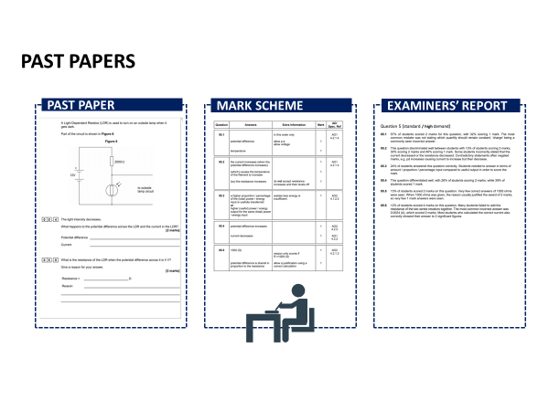

Slide 40

TESTING = BEING BRAVE
1% MARGINAL GAINS;
-each week,
-on each practice question,
-in each subject…….

Slide 41

Revision Planning
Making the revision timetable

Slide 42
Revision Planning
Making the revision timetable
Only 49% of Year 11 students made
a revision timetable for their mock exams!

Slide 43
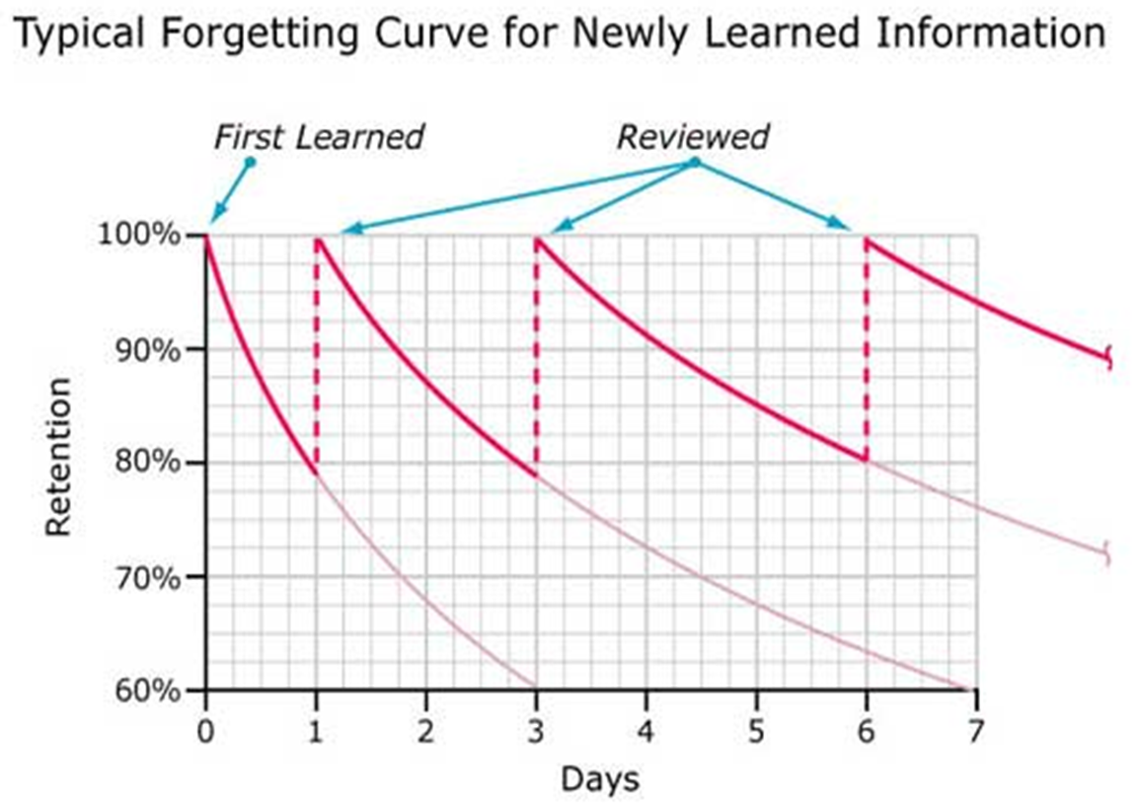
Principle 1: SPACED RETRIEVAL PRACTICE
When we learn something, we forget it
When we revisit something we’ve learned repeatedly, we remember it better
This is shown in the Ebbinghaus Forgetting Curve

Slide 44
Principle 1: SPACED RETRIEVAL PRACTICE
Only 47% of Y11s used this for the mocks!
When we learn something, we forget it
When we revisit something we’ve learned repeatedly, we remember it better
This is shown in the Ebbinghaus Forgetting Curve

Slide 45
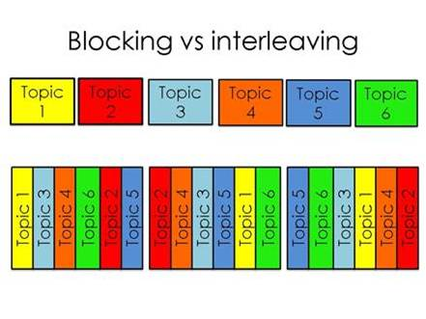
Principle 2: Interleaving vs blocking
“Blocking” your revision – focusing on one topic for a long time then moving on to the next topic – is inefficient.
“Interleaving” your revision is far more effective as reducing the accessibility of information in memory fosters additional learning of that information.

Slide 46
Principle 3: Interleaving and chunking
For interleaving to work, you have to break down your revision into “chunks”
It’s no good putting “Biology” into your revision calendar – you need to be specific
GCSE Biology includes:
  Health
  Responses to the environment
  Evolution
  Ecology
  Cells
  Photosynthesis
  Organisms and their environments
  Protein functions and uses
  Respiration
  Genetics
  Speciation

Slide 47
Easter Revision
I suggest that for at least 5 days a week over the Easter holiday, students work a school day:
Session 1 – 9:00-9:50
Session 2 – 10:15-11:05
Session 3 – 11:30 – 12:20
Session 4 – 1:15 – 2:05
Session 5 – 2:30 – 3:20
They could even follow their school timetable.

Slide 48
Revision timetable
Date/Session | Revision | Activity
Mon 30th March 1 | Geog: Coasts | Review –Quizlet flashcards
2 | RE: Christian marriage | Transform – Revision clock
3 | Maths: quadratic equations | Test – Practice Paper Q2,4,6
4 | Eng Lit: Macbeth | Transform – Lady Macbeth folding frenzy
5 | Science: Forces | Review – Seneca website

Slide 49

The importance of study breaks:
Study time periods should be broken down into 20-25 minute sections with small rests in between.
We tend to remember first things and last things rather than the things in between. So, the more well-spaced and short breaks we have, the more beginnings and endings we have, and the better our brain will be able to remember.
Brief breaks are also essential for relaxation: they relieve the muscular and mental tension that inevitably builds up during periods of intense concentration.

Slide 50


Slide 51

Time spent planning is likely to reduce stress – parents can be very helpful here!

Slide 52
Exam Day
Be prepared.
2. Try a breathing exercise if you're feeling overwhelmed. Breathe in through your nose for 4 counts, hold it for 2 counts, and breathe out for 7 counts. Repeating this can help you feel calm.
3. Take a few minutes to read the instructions and questions.
4. Plan how much time you'll need for each question.
5. Once the exam is finished, forget about it.

Slide 53
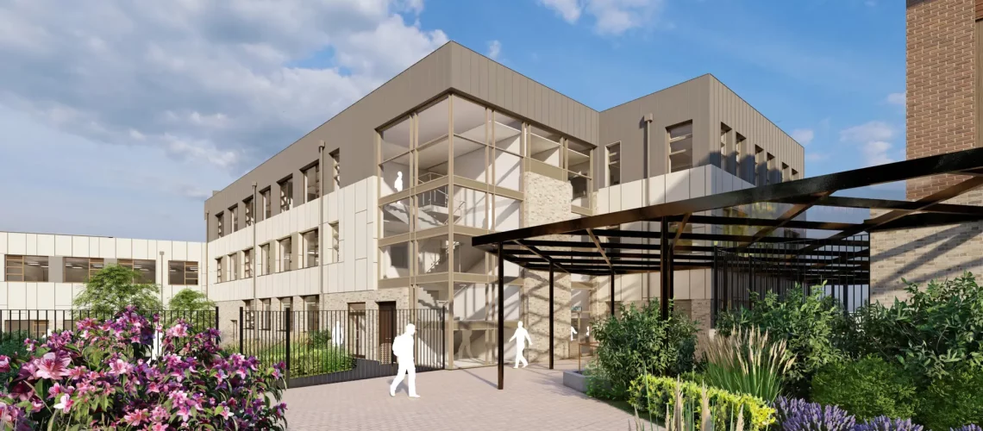
A level of anxiety around exams is unavoidable. So in school we offer:
Exam management and timetabling techniques sessions
Revision classes after school
NEA support at lunchtimes
A dedicate Year Group Team
Access to student services

Slide 54

Reducing Exam Stress
at Home
Spot the signs and talk about it.
Listen!
Help to build a sustainable routine.
Do what you can not to add to the pressure.
Provide opportunities to unwind after each exam and celebrate the successes.
Visit www.place2be.org.uk/navigating-exam-season-guide-for-parents.pdf

Slide 55




Signpost your children to use the following services to support them through
this period or if things get too much.
Lets Talk Well
Guide to Coping with
Exam Stress
Text CONNECT to 85258 for free to speak to Shout
Call 0800 1111
To speak to Childline or visit their website

Slide 56






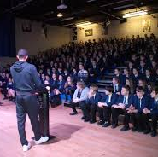
Things to Look Forward To
Last EVER School Photos
End of Exams
Prom
6th March
21st April
1st May
16th June
25th June
8th July
World Book Day
Looking Ahead Day
Celebration of Achievement

Slide 57


Slide 58


