Slide 1

Year 8 Information Evening
15th October 2025

Slide 2
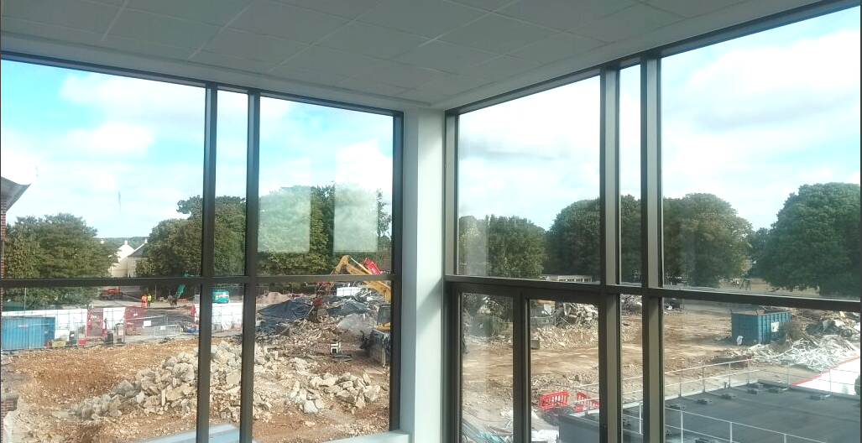

Notes:
Successful demolition phase of existing structures.
DT will be done this term.
Separation of mixed materials.
Created the deeper turning circle, beginning the SH extension foundations.

Slide 3
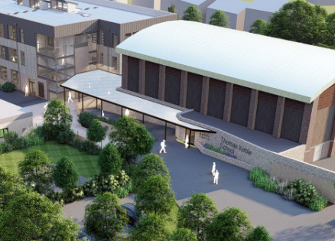

Slide 4
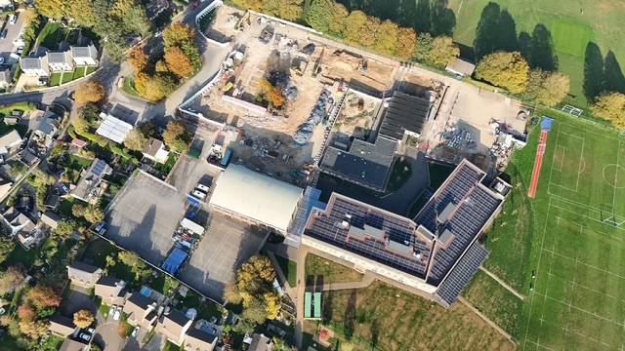

Slide 5
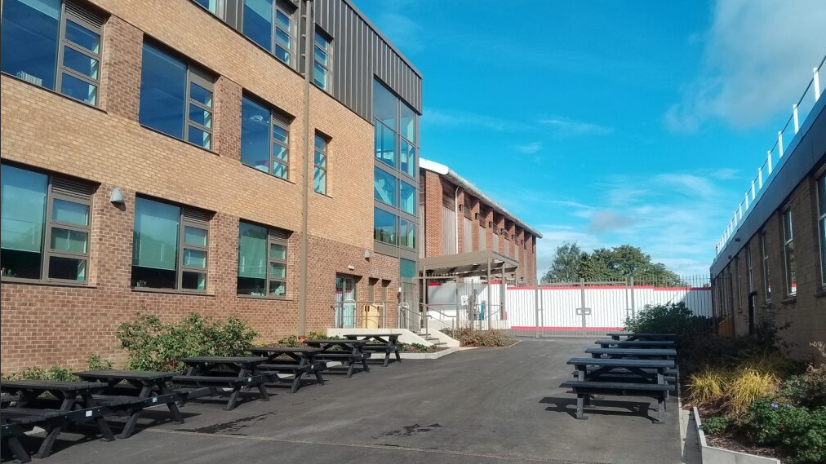

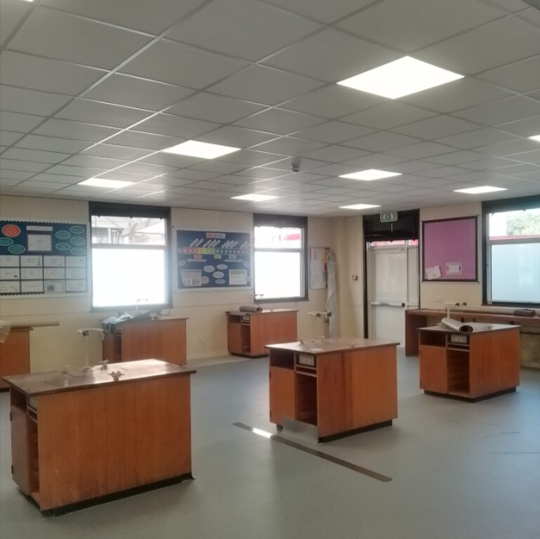
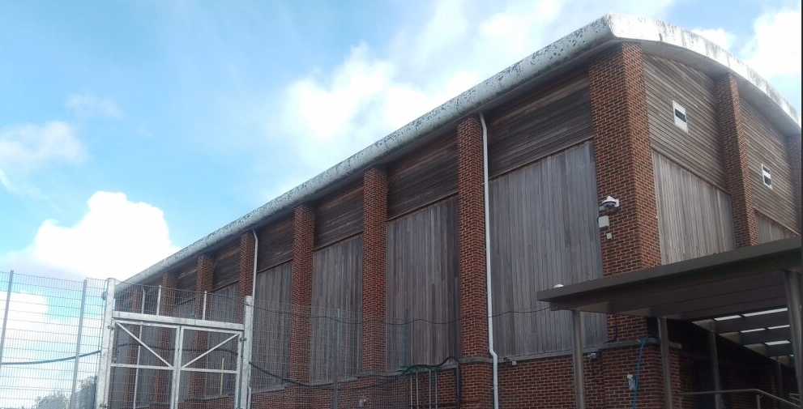
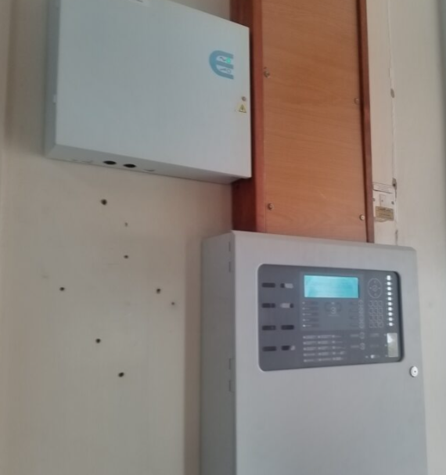

Slide 6
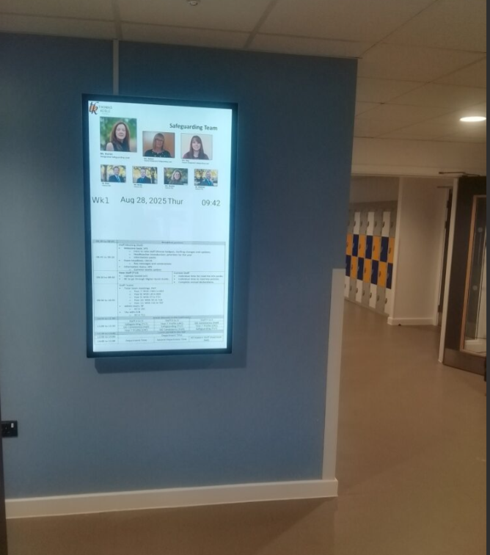
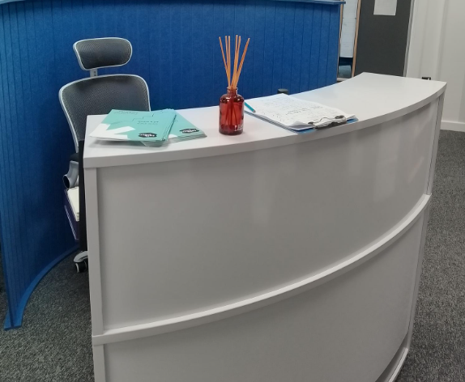

Slide 7
Term lengths across the year
September
October
November
December
January
February
March
April
May
June
July
8
7
6
5
6
7

Slide 8
Reports on progress and meetings in school (Y8)
Report 1
GRIT awards 1
(04/11/25)
Report 2
GRIT awards 2
(29/04/26)
September
October
November
December
January
February
March
April
May
June
July
Information
Evening
(13/10/25)
Assessments
(02/03/26 to 06/03/26)
Parents
Evening
(30/04/26)

Slide 9
Events and activities (Y8)
House Sport
House English
House
Sport
House
Art
House
Festival
Sponsored
Walk
Winter
Showcase
Sports
Day
School
Production
September
October
November
December
January
February
March
April
May
June
July
Careers
Dance
Show

Slide 10
During the day and after school activities
Day | Time | Activity
Monday | Lunchtime | TK voices , Drama club and Animal Club
 | After school | Rugby
Tuesday | Lunchtime | Spanish comic book club, Science club , Animal Club and Badminton Club
 | After school | Homework support - all year groups, Art club, Maths club and Beginner flute club (invite)
Wednesday | Lunchtime | KS3 Textiles, Intermediate Flute Group (invite), Dance club, Animal Club and Basketball (Weeks 1 only)
 | After school | Netball and X-country running
Thursday | Lunchtime | DT club, Netball, Debating club and Animal Club
 | After school
Friday | Lunchtime | Crafting – crochet, journaling, card making etc , Animal Club and Languages Club
 | After school | Girls rugby

Slide 11

Attendance
Notes:
Attendance
Why it matters
DfE direction
Absences and examples.
What we do

Slide 12
New guidance that schools must follow
Daily Attendance Data Sharing.
Limited Exceptional Circumstances for authorised absence.
10 sessions of unauthorised absence within 10 school weeks

Slide 13
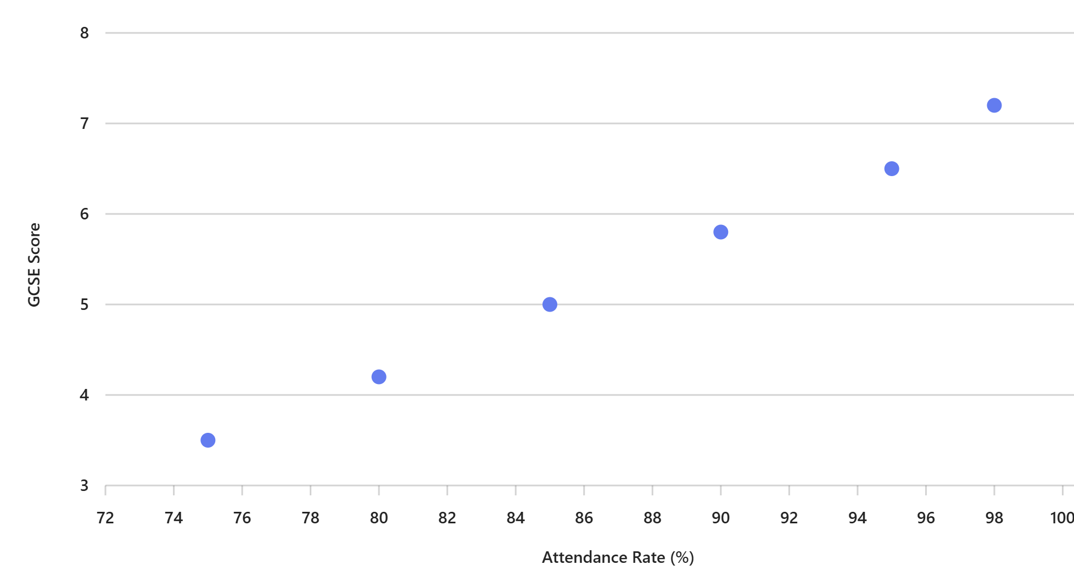
Attending nearly every day in Year 11:
2 x as likely to achieve Grade 5 in English and Maths, compared to 90% to 95% attendance.
3 x as likely to achieve Grade 5 in English and Maths, compared to 85% to 90% attendance.
The link between attendance and attainment in an assessment year
March 2025, Department for Education
Notes:
Department for Education research shows that 17 school days of absence results in all of a student’s GCSE grades dropping by one grade.

Slide 14

Notes:
Department for Education research shows that 17 school days of absence results in all of a student’s GCSE grades dropping by one grade.

Slide 15
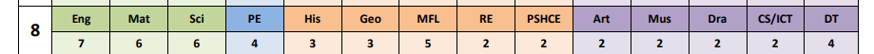
Tutors Groups
Mixed Groups: Humanities, Arts and Computing
Mixed Groups: MFL and DT
Streamed groups: Maths, Science, PE

Slide 16


Slide 17
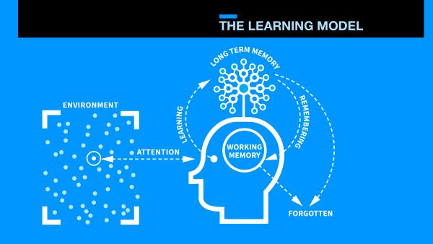

Slide 18
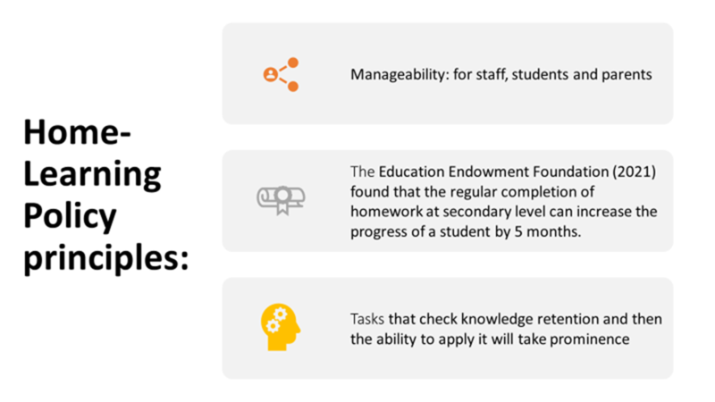

Slide 19
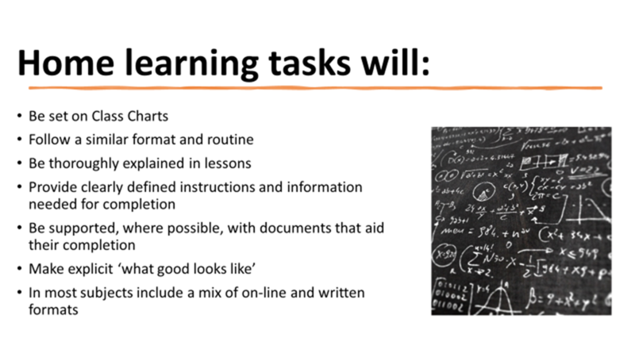

Slide 20
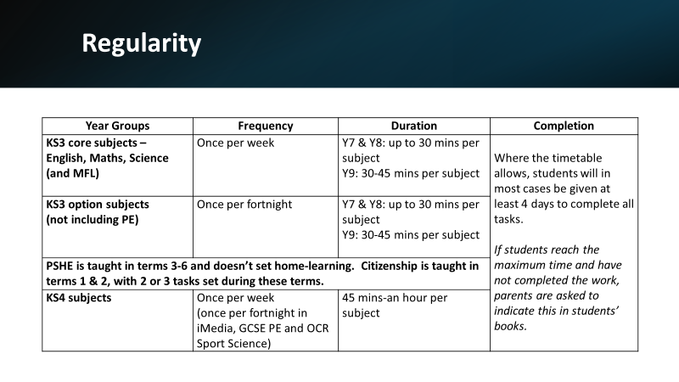

Slide 21
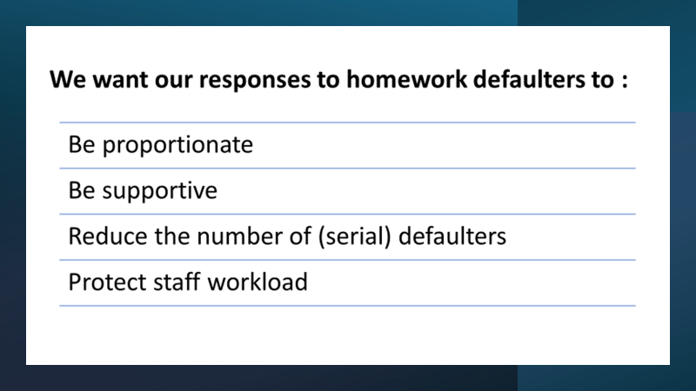

Slide 22
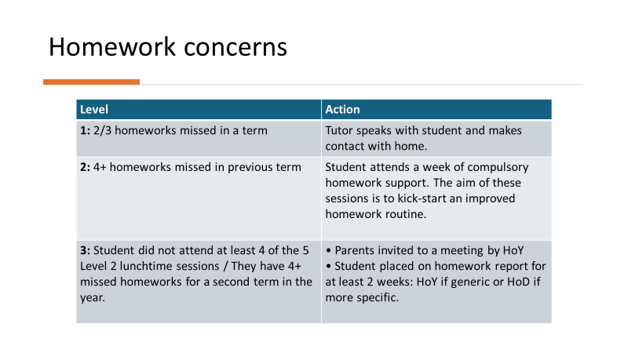

Slide 23
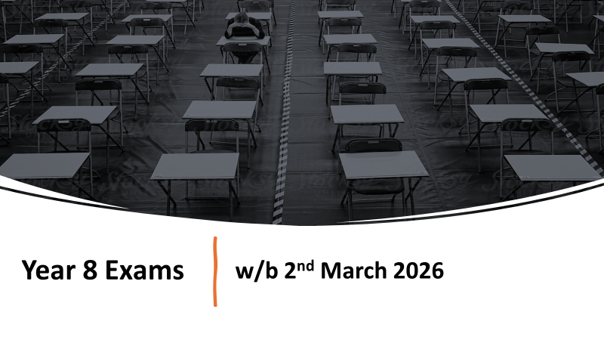

Slide 24


Slide 25
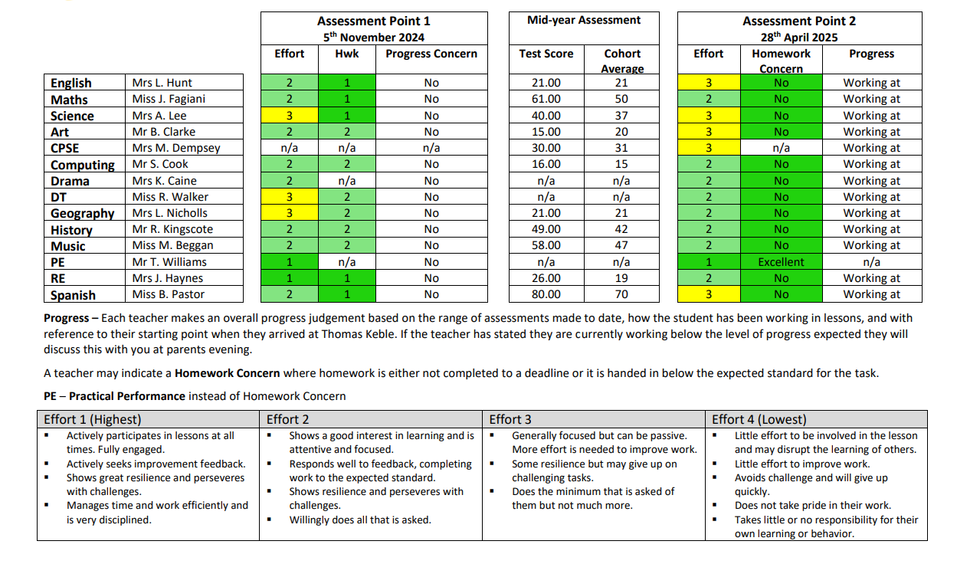

Slide 26
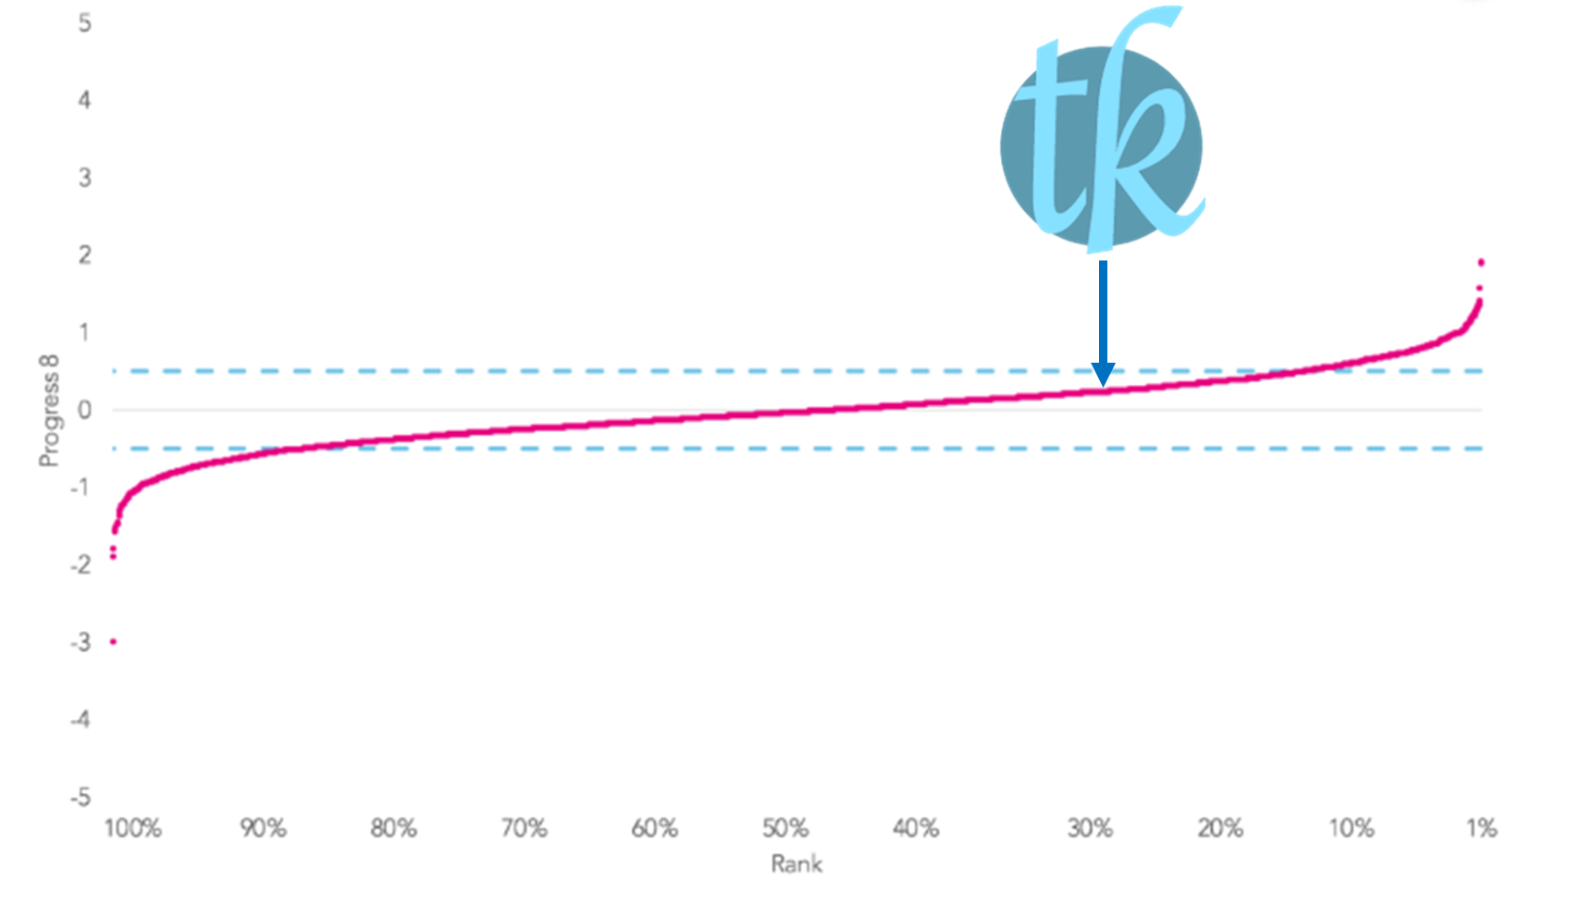

Slide 27


Behaviour and Rewards

Slide 28
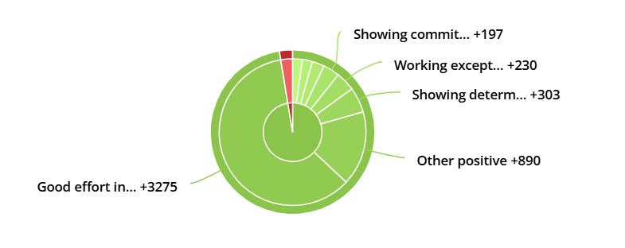
Year 8 behaviour pie chart
5278
97%

Slide 29


Slide 30


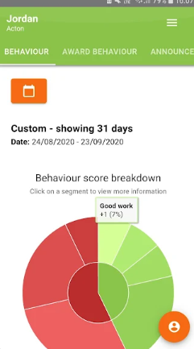
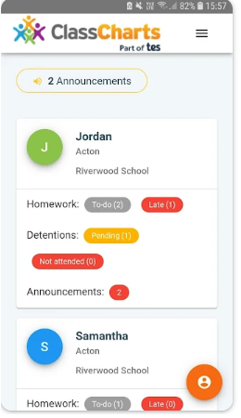
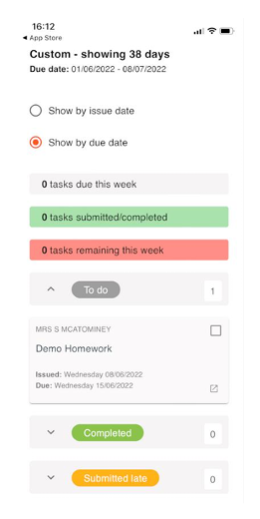



Slide 31

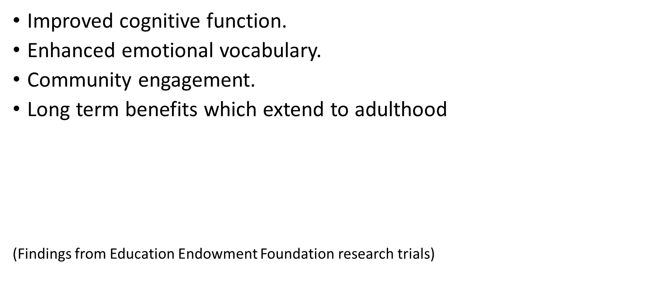

Slide 32
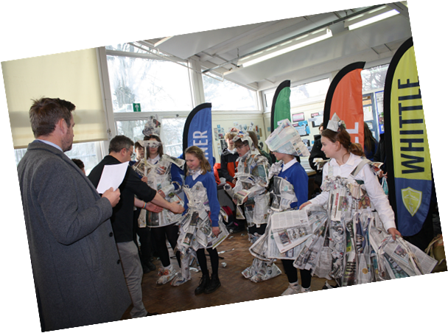
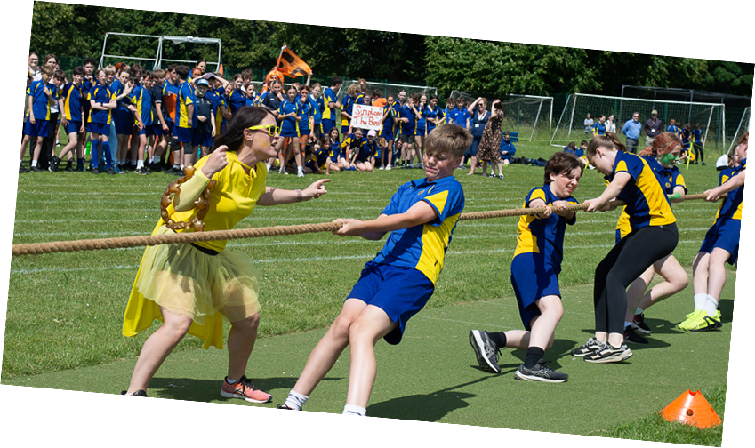
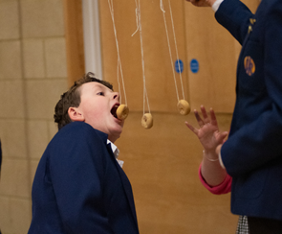

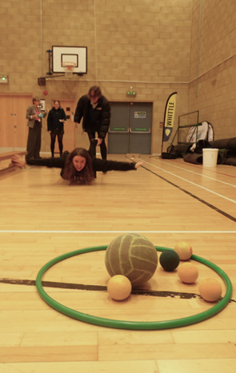
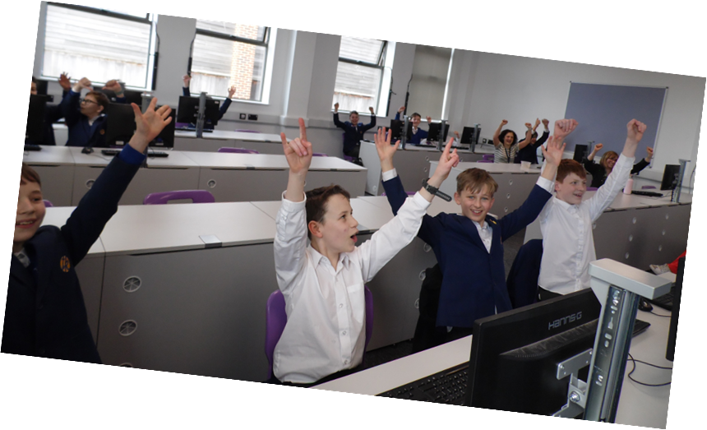
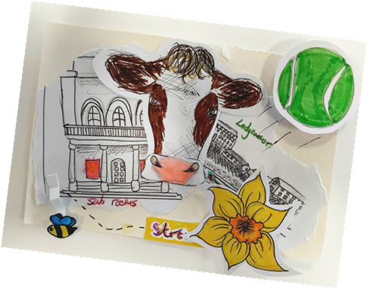

Slide 33


Sponsored Walk - Friday 29th September
St Peter's Hospice, Bristol
The Disaster Emergency Committee
Thomas Keble PTA
ThePhoto by PhotoAuthor is licensed under CCYYSA.

Slide 34
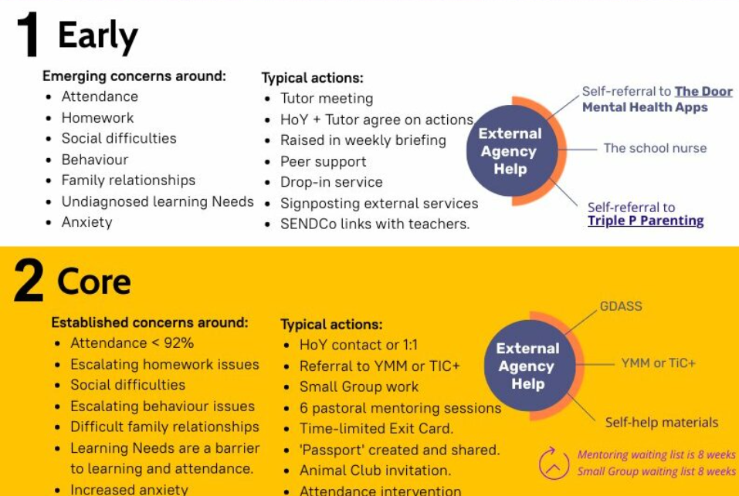

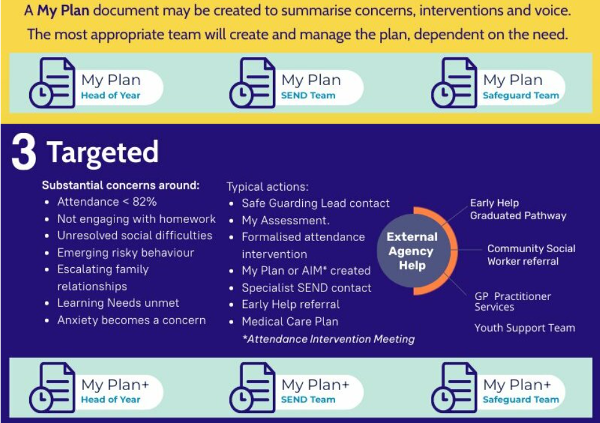
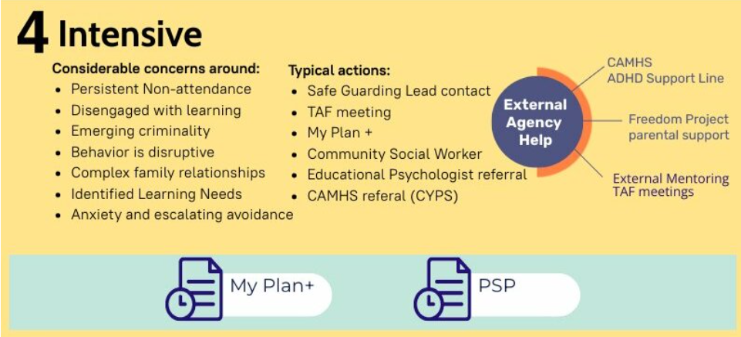


Slide 35

HOME –SCHOOL PARTNERSHIP

Slide 36
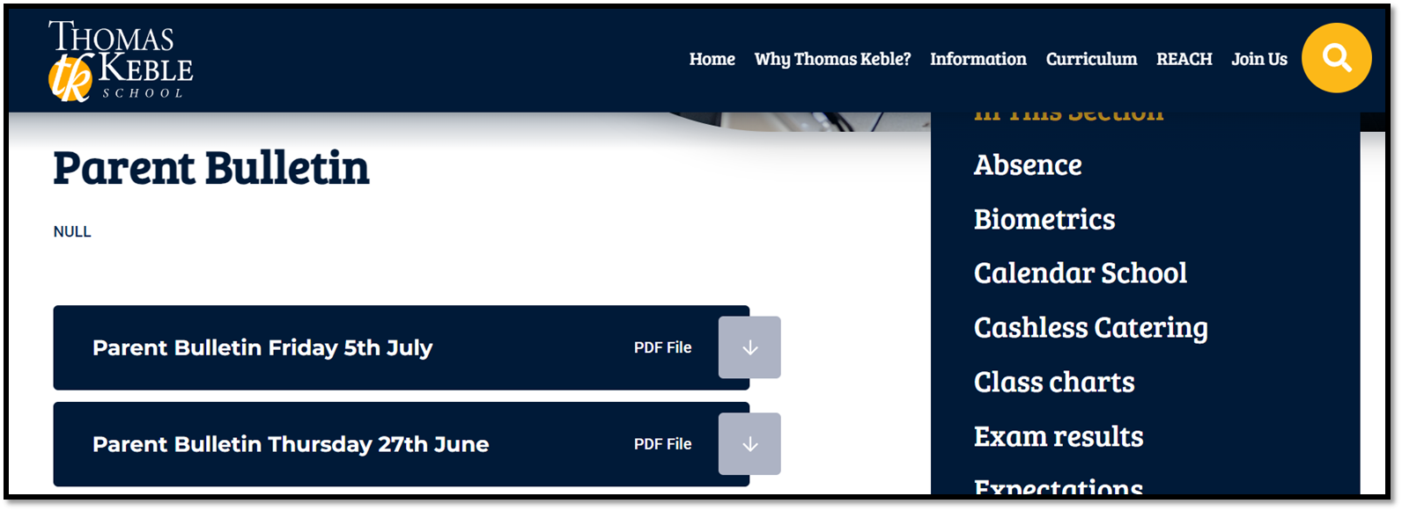
admin@thomaskeble.gloucs.sch.ukk

Slide 37


